Slide 1
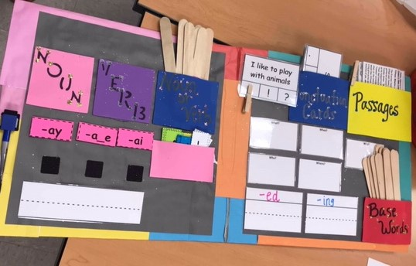
Prescribing Multisensory Lapbooks for Literacy Interventions
A multisensory approach to reading comprehension, phonics instruction, and fluency interventions for the elementary grades.
Stefanie Sorbet, Ed. D

Slide 2
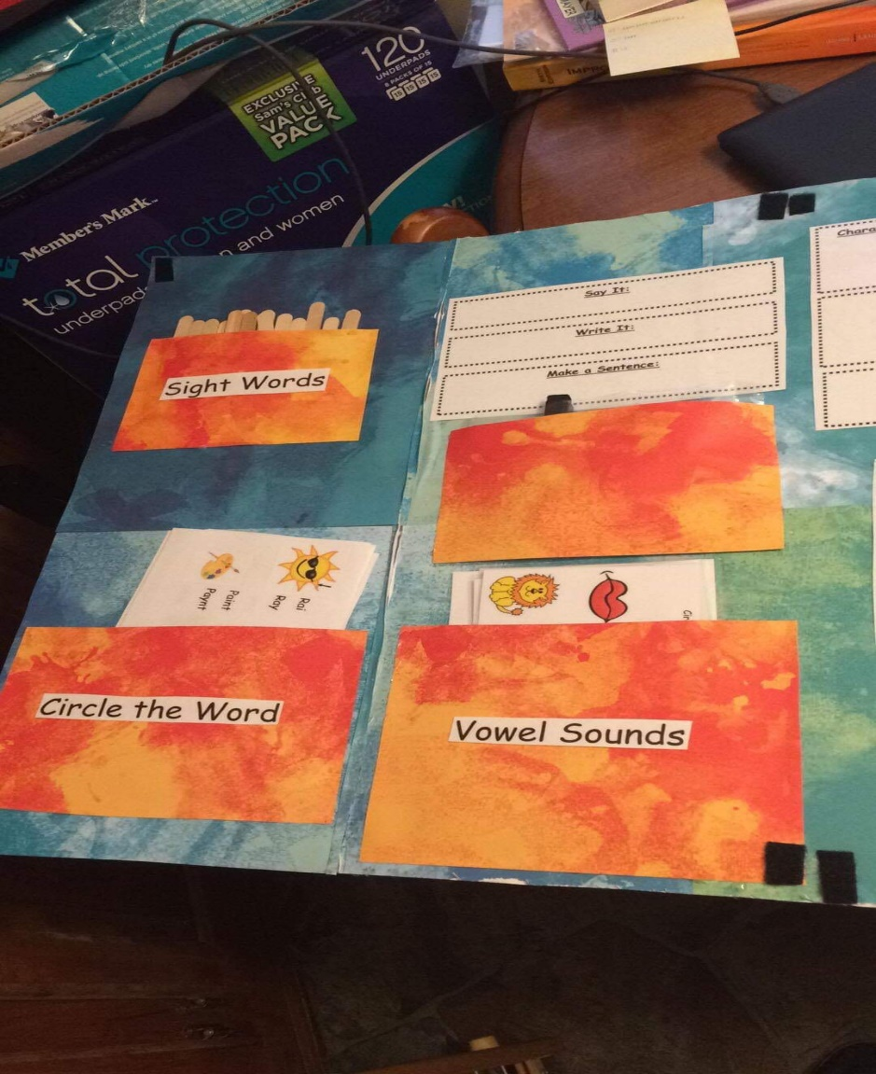

Slide 3
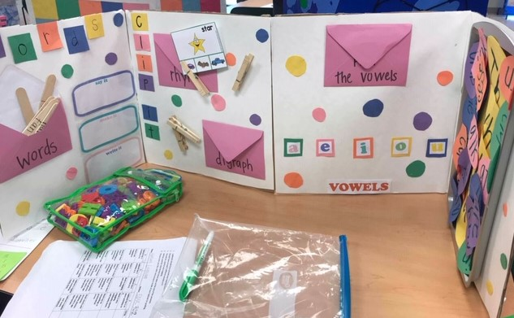
Lapbooks
Lapbooks can be made with almost anything.
Posterboards, file folders, cardboard, cardstock. Scrapbooking papers, and many other materials make the book inviting to students.
The key is to catch the children’s eye and engage them in working on the skill.
These are ever-changing and adaptive to your students’ literacy needs.

Slide 4
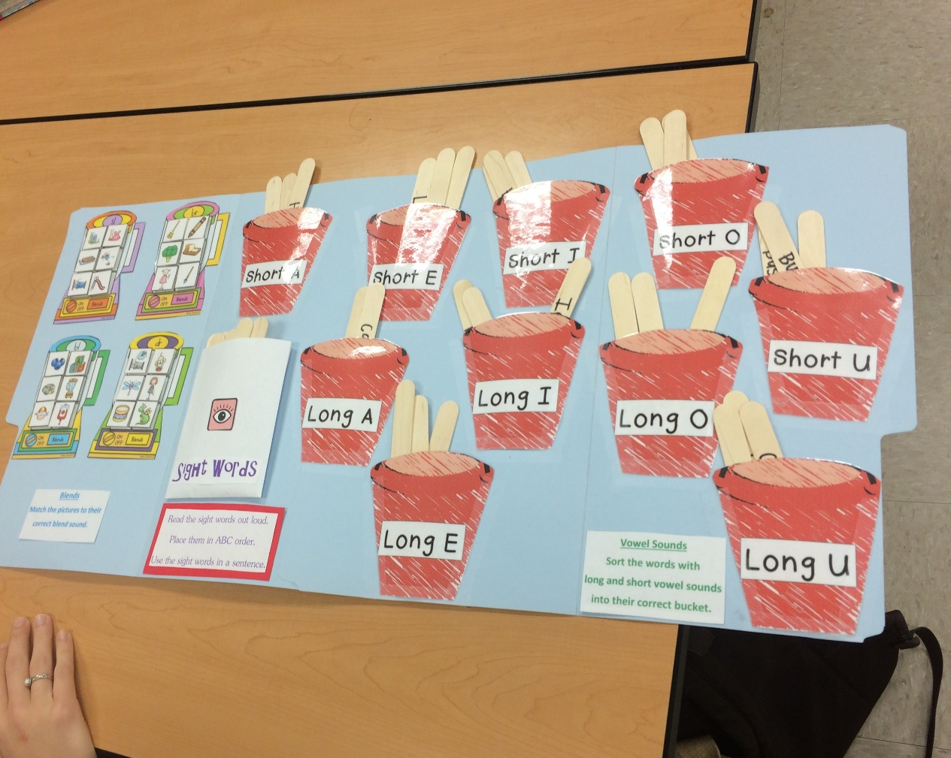

Slide 5
Why Lapbooks?
Preservice elementary education students in an elementary education literacy diagnostics course worked with first graders in a public elementary school in southeastern Louisiana to determine any deficits in phonics, reading and fluency, and reading comprehension.
Students administered a variety of diagnostic tests to these first grade students determine the areas of deficit to include phonics skills, comprehension concerns, fluency difficulties, and other literacy difficulties to first grade students.

Slide 6
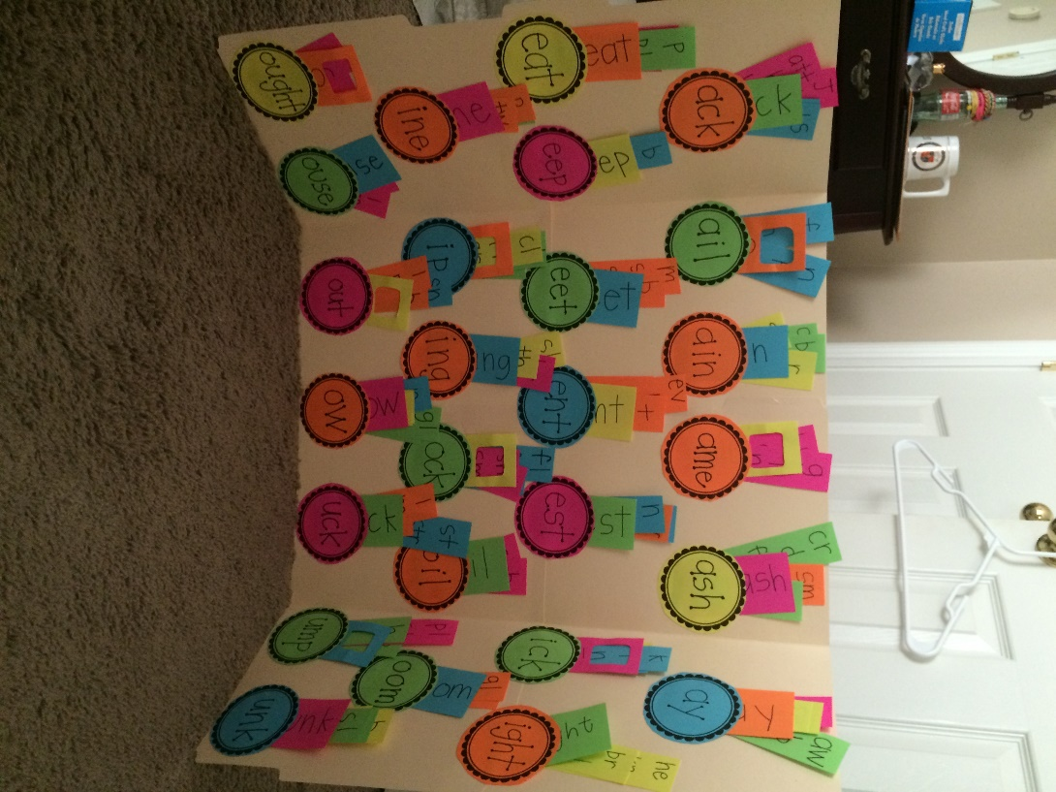
The lapbooks were geared to meet the skill deficits of that specific child through engaging activities focused to enhance and improve the child’s abilities in reading fluency, comprehension and/or phonics skills.
The requirements for the preservice teachers were that the lapbooks had to be aligned to the Louisiana State Student Standards in literacy, meet the needs of their student, have at least five different hands-on activities, and be engaging for the child.

Slide 7
The lapbooks encouraged the first graders to approach their own literacy deficit in a fun and more interactive way and began to foster a more positive attitude in struggling readers.
The lapbooks were colorful and engaging for the first graders and these students were excited about learning and interacting with the preservice teachers in this activity.

Slide 9
Who benefits from lapbooks?
Start with the student who needs a specific skill.
When you pull your small reading groups for guided reading or intervention time, what specific skills do your students need? Have you assessed to determine deficits?
Target these key areas and create prescribed lapbooks for fun learning.
Provide these lapbooks for student’s to use with you and in free time-just a few minutes each session.

Slide 11
Phonics skills
Prefixes
Suffixes
Plurals
Compound words
CVC patterns and rules
R-controlled vowels
Silent or magic “e”

Slide 12
Making Words Letters
A B C D E F G
H I J K L M N
O P Q R S T U
V W X Y Z

Slide 13
Directions for Making Words
Cut out letters and place in envelope or ziploc baggie.
Start with calling out a small word
Have students spell that word on their work mat
Add to the word as the students add another letter and make larger words
Have students create a large word that has several of the letters included
*You may want to duplicate more vowels or extra letters before beginning
https://www.youtube.com/watch?v=7nxljktf-Hw

Slide 14
Attach this mat within your lapbook
Making Words Work Mat

Slide 15
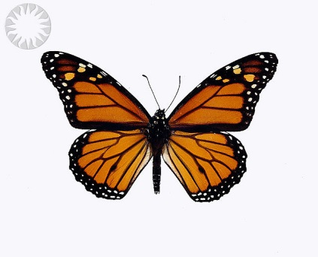
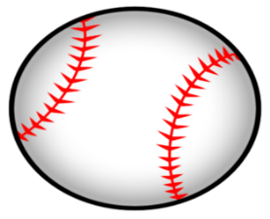
Compound Words
book
base
Cut out each picture find the matching picture that goes with the compound word.
butter
ball
Write a sentence using a compound word:
________________________________________________________________________________________________
cook
fly

Slide 16
Comprehension skills
Inferencing
Cause and effect
Drawing conclusions
Author’s purpose
Story elements
Retellings

Slide 17
5 finger retelling
problem
highest point
setting
resolution
characters
summary
title and author

Slide 18
Retelling Sidewalk
Author:
Title:
Setting:
Genre:
First:
Next:
Last:
Then:
Problem:
Highest Point:
Solution:

Slide 19
Story Map House
Title:
Author:
Genre:
Characters:
Setting:
Summary:

Slide 20
Cause and Effect
The cause is what happened first and the effect is a result of the cause.
Because the class stopped talking, permission was given to go to recess.
The effect is the second part of the idea that usually tells what might happen because the first thing happened. It is called the effect.
The class stopped talking so permission was given to go to recess.

Slide 21
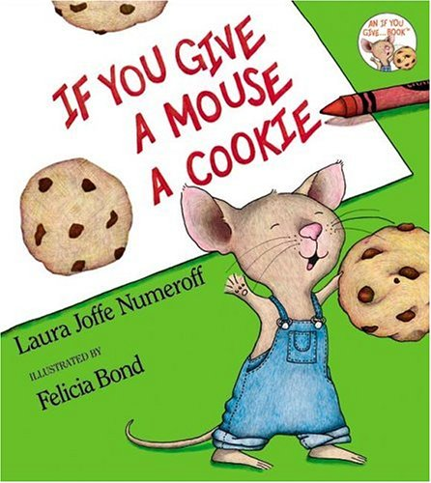
Game
Directions:
In your small groups, you will have a set of cookies and milks to put together.
Rearrange your cookies and milks on the center of your desk area and match the milks with the cookies.
Each cookie is a cause and each milk is an effect.

Slide 22
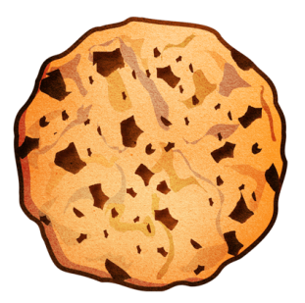
Cause
If you don’t study for your spelling test…
Effect
You will have to buy some dog food.
Effect
You will make a low grade.
Cause
If you don’t tie your shoelaces…
Cause
If you get a new puppy…
Effect
He’s going to ask for a glass of milk.
Cause
If you give a mouse a cookie…
Effect
You will trip and fall.

Slide 23
Add in technology
Within your lapbook you could easily include a pocket containing a tablet or Ipad for early finishers or an incentive to motivate students to complete your lapbook skill activities.

Slide 24
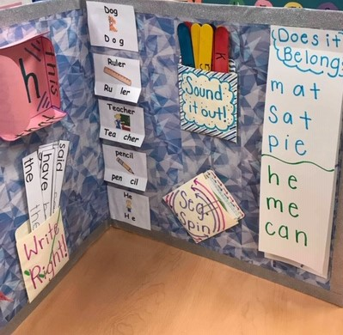
Lapbooks
Key points:
Gear lapbooks to fit your learners’ needs
Make them fun, inviting and engaging
Can be made with anything
Encourage students to use these with you and in free time
Incorporates choice, tactile learning, and prescribed to meet individual deficits and needs.

Slide 25
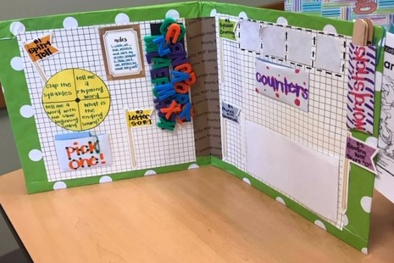
Let’s Make and Take LAPBOOKS
Plan-BLUEPRINT
Create-Getting Crafty
Adjust-add too or take away and adjust to meet the reader’s needs on an ongoing basis

Slide 26
Lapbook blueprint
Think about a struggling reader you may know.
What skill deficits do you see in him/her/them?
Do you need to further evaluate or assess to determine areas of deficit? (phonemic awareness, fluency, etc)
Based on your findings, create interchangeable activities that are centered around these skill areas to support the reader.
Create your lapbook according to these needs.
Allow for interchcangeable parts to adjust as the reader needs more or less support and/or advances to the next level.

Slide 27
Templates for lapbook flash cards and pockets

Slide 28
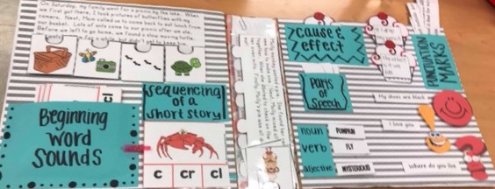
Getting CRAFTY
Materials provided to get started

Slide 29
For more information:
Stefanie Sorbet, Ed.D
Email: ssorbet1@uca.edu

