Slide 1
Charlie May Simon
Reading List
2019-2020
Margie Nanak, NBCT
November 14-15, 2019

Slide 3
GUIDELINES
For students in grades four, five and six
Students must have read three books or have heard
three books
Students vote for one book

Slide 4
GUIDELINES
It is hoped the children will discuss the books that they have read
and as a result will become more thoughtful readers.
One person at the school will collect the votes and submit the
count to the Department of Education in early May

Slide 5
CRITERIA
Books that are third in a series or beyond will not be considered
Books that fall in this category may be considered if recommended by a teacher, library media
specialist or committee member.

Slide 6
CRITERIA
Books on the 2019-2020 must have been published in 2017.
The author must reside in the United States.
Books published in a previous year or a foreign country will not be considered
Adaptations, retellings and translations will not be considered
The author must be living
Books that children will read anyways are generally not included.

Slide 7
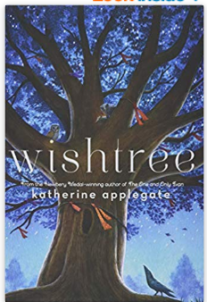
WISHTREE
By Katherine Applegate
Summary: An old red oak tree tells how he and his crow friend, Bongo, help their human neighbors get along after a
threat against an immigrant family is
carved into the tree's trunk.

Slide 8
WISHTREE
Genre: Fantasy
Accelerated Reader BL 4.2 Points 3.0
Reading Counts RL 3.3 Points 6
Lexile 590
F&P T
Word count 19388
Pages 215

Slide 9
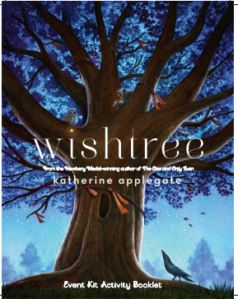
WISHTREE
Author’s website http://katherineapplegate.com/
Book discussion: https://www.plt.org/recommended-reading/wishtree/
Book unit: https://bookunitsteacher.com/wp/?p=5932
Activity kit: http://wishtreebook.com/static/pdf/wishtree-activity-kit-final.pdf
Teacher’s guide: https://images.macmillan.com/folio-assets/teachers-guides/9781250043221TG.pdf
Discussion questions: https://nancymcginleymyers.wordpress.com/2018/02/10/book-club-questions-wishtree-by-katherine-applegate/
Youtube – Author discusses Wishtree: https://www.youtube.com/watch?v=rn6PclDRsE8
Book trailer: https://www.youtube.com/watch?v=-P5TSKKBIyo
Lesson ideas: http://www.theclassroombookshelf.com/2018/01/wishtree/

Slide 10
THE WAR I FINALLY WON By Kimberly Brubaker Bradley
Summary: As the frightening impact of
World War II creeps closer and closer to her door, eleven-year-old Ada learns to
manage life on the home front.

Slide 11
THE WAR I FINALLY WON
Genre: Historical fiction, World War II
Accelerated Reader BL 3.7 Points 9.0
Reading Counts RL 4.1 Points 15
Lexile 520 HL
Word count 67377
Pages 385
New York Times bestseller
Boston Globe Best of the Year
Hornbook Fanfare 2017

Slide 12
THE WAR I FINALLY WON
Author’s website: https://kimberlybrubakerbradleycom.wordpress.com/
Book trailer: https://www.youtube.com/watch?v=QJx3J61VzPw
Author discusses book: https://www.youtube.com/watch?v=AX8BJAFiF-c
World War II facts for children: https://kids.kiddle.co/World_War_II
World War II Facts for children: https://www.ducksters.com/history/world_war_ii/
Library of Congress primary sources: www.loc.gov

Slide 13
THE WAR I FINALLY WON
MIDDLE SCHOOL BOOKS ABOUT WORLD WAR II
Don’t you know there’s a war on? Avi
Number the stars by Lois Lowry
When my name was Keoko by Linda Sue Park
Yellow star by Jennifer Roy
Green glass sea by Ellen Klages
Why did the whole world go to war? : and other
questions about-- World War II Martin W. Sandler
For Freedom by Kimberly Brubaker Bradley
Candy bomber by Michael O. Tunnell
In defiance of Hitler by Carla Killough McClafferty
Genevieve’s war by Patricia Reilly Giff

Slide 14
www.loc.gov

Slide 15
OLDER THAN DIRT: A WILD BUT TRUE HISTORY OF EARTH By Don Brown and Mike Perfit
Summary: A graphic
novel about world geology
and our planet's natural
history.

Slide 16
OLDER THAN DIRT
Genre: Nonfiction, Graphic novel
Accelerated Reader BL 4.8 Points 1.0
Reading Counts RL 5.5 Points 5
Lexile 730 GN
Word count 6115
Pages 104

Slide 17
OLDER THAN DIRT
Author website: http://www.booksbybrown.com/
NSTA Resources and lesson planning: https://ngss.nsta.org/DisplayStandard.aspx?view=topic&id=35
Geologic time line lesson plan: https://www.keslerscience.com/geologic-time-scale-lesson-plan-a-complete-science-lesson-using-the-5e-method-of-instruction/
NSTA Resources and lesson planning: https://ngss.nsta.org/DisplayStandard.aspx?view=topic&id=35
Video Geologic time scale: https://www.teachingchannel.org/video/teaching-geological-time
Children’s literature about geology: http://www.carolhurst.com/subjects/geology.html

Slide 18
LOSER’S CLUB By Andrew Clements
Summary: Alec, a sixth-grade bookworm
always in trouble for reading instead of
listening and participating in class, starts a book club, solely to have a place to read,
and discovers that real life, although
messy, can be as exciting as the stories in his favorite books.

Slide 19
LOSER’S CLUB
Genre: Realistic fiction, School story
Accelerated Reader BL 5.5 Points 7.0
Reading Counts RL 5.6 Points 13
Lexile 860
F&P T
Word count 46368
Pages 231

Slide 20
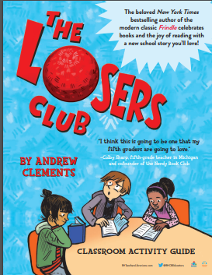
LOSER’S CLUB
Author website: https://www.andrewclements.com/
Excerpt from audio: https://www.youtube.com/watch?v=LAKp-lSreyo
Book trailer: https://www.youtube.com/watch?v=LAKp-lSreyo
Classroom activity guide: https://images.randomhouse.com/promo_image/9780399557552_4946.pdf
Five questions for Andrew Clements https://www.hbook.com/2017/08/authors-illustrators/interviews/five-questions-for-andrew-clements/

Slide 21
SUPERSTAR By Mandy Davis
Summary: Space-obsessed Lester
Musselbaum experiences the challenges of his first days of public middle school,
making friends and enemies, accidentally
learning of his autism-spectrum diagnosis, and finding his "thing."

Slide 22
SUPERSTAR
Genre: Realistic fiction
Accelerated Reader BL 3.8 Points 9.0
Reading Counts RL 3.3 Points 14
Lexile 580
Word count 61849
Pages 320

Slide 23
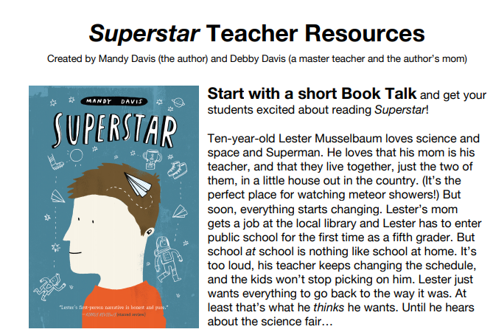
SUPERSTAR
Author website: https://mandydavis.com/
Teacher resources: https://ubermandy.files.wordpress.com/2018/09/superstarteacherresources1.pdf
For kids: https://mandydavis.com/forkids/
Explaining autism to children: https://kidshealth.org/en/kids/autism.html
Partner with
Rules by Cynthia Lord
Temple Grandin by Sy Montgomery
Al Capone does my shirts by Gennifer Choldenko
Anything but typical by Nora Raleigh Baskin
Mockingbird by Kathryn Erskine
Rain reign by Ann M. Martin

Slide 24
GENEVIEVE’S WAR By Patricia Reilly Giff
Summary: In August 1939 Genevieve makes an impulsive decision not to get on a train to take her to a boat back to New York and must spend the duration of World War II with her grandmother
in a small village in Alsace, France,
where she becomes involved with the French resistance.

Slide 25
GENEVIEVE’S WAR
Genre: Historical fiction, World War II
Accelerated Reader BL 4.0 Points 5.0
Reading Counts RL 3.2 Points 11
Lexile 550
Word count 35648
Pages 222

Slide 26
GENEVIEVE’S WAR
Also by Patricia Reilly Giff
World War II
Lily’s crossing
Island war
Willow run
Gingersnap
Other books
When my name was Keoko by Linda Sue Park
Paper wishes by Lois Sepahban
Dash by Kirby Larson

Slide 27
BAN THIS BOOK By Alan Gratz
Summary: A fourth grader fights back
when From the Mixed-Up Files of Mrs.
Basil E. Frankweiler by E. L. Konigsburg is challenged by a well-meaning parent and
taken off the shelves of her school library. Amy Anne is shy and soft-spoken, but don't mess with her when it comes to her
favorite book in the whole world.

Slide 28
BAN THIS BOOK
Genre: Realistic fiction
Accelerated Reader RL 4.5 Points 7.0
Reading Counts RL 4.3 Points 11
Lexile 690
Word count 45952
Pages 255

Slide 29
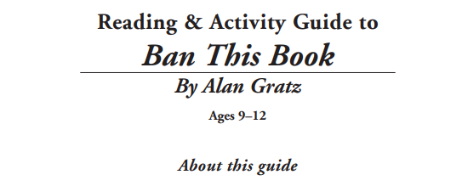
BAN THIS BOOK
Author website: https://www.alangratz.com/
Teacher’s Guide: https://www.hachette.com.au/content/resources/9780734417824-teachers-notes.pdf
Book Trailer: https://www.youtube.com/watch?v=sjSTyPk31v0
Teachers pay teachers: (fee) https://www.teacherspayteachers.com/Product/Ban-This-Book-Chapter-by-Chapter-Comprehension-Questions-3589065
Teachers Pay Teachers: (fee) https://www.teacherspayteachers.com/Product/Ban-This-Book-Over-100-EBOB-Questions-3919234

Slide 30
BLOOMING AT THE TEXAS SUNRISE MOTEL By Kimberly Willis Holt
Summary: After the sudden death of her
parents, Stevie, thirteen, is sent to live at a rundown motel, where she charms
everyone except her estranged grandfather.

Slide 31
BLOOMING AT THE TEXAS SUNRISE MOTEL
Genre: Realistic fiction
Accelerated Reader RL 4.2 Points 8
Reading Counts RL 4.5 Points 14
Lexile 620 HL
Word count 53734
Pages 328

Slide 32
BLOOMING AT THE TEXAS SUNRISE MOTEL
Author website: http://www.kimberlywillisholt.com/
Book : https://www.youtube.com/watch?v=lSTmHYo7kfg
Book trailer: https://www.youtube.com/watch?v=lSTmHYo7kfg&list=PLpbLWN9SaSqSCj5SkJk5ozEQ20eFbCrZ6&index=5

Slide 33
HIDEOUT By Watt Key
Summary: The son of a Mississippi policeman finds a boy living in hiding in the
wilderness and tries to help him without
giving away his secret.

Slide 34
HIDEOUT
Genre: Realistic fiction, Adventure, Mystery
Accelerated Reader RL 4.2 Points 9 IL MG+
Reading Counts RL 3.5 Points 16
Lexile 630
Word count 62572
Pages 311

Slide 35
HIDEOUT
Author website: https://wattkey.com/
Teacher’s guide: https://images.macmillan.com/folio-assets/teachers-guides/9781250143976TG.pdf
Book trailer: https://www.youtube.com/watch?v=2c9D0beb-XM

Slide 36
RESTART By Gordon Korman
Summary: Chase does not remember
falling off the roof, in fact he does not
remember anything about himself, and
when he gets back to middle school he
begins to learn who he was through the
reactions of the other kids--trouble is, he
really is not sure he likes the Chase that is being revealed, but can he take the
opportunity amnesia has provided and
restart his life?

Slide 37
RESTART
Genre: Realistic fiction
Accelerated Reader RL 5.1 Points 9
Reading Counts RL 4.5 Points 14
Lexile 730
Word count 59925
Pages 243

Slide 38
RESTART
Author website: http://gordonkorman.com/
Activities: https://bookunitsteacher.com/wp/?p=6088
Teachers pay teachers (fee) Several novel studies available
Partner with
Save me a seat by Sarah Weeks and Gita Varadarajan

Slide 39
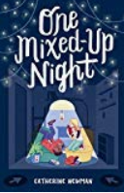
ONE MIXED UP NIGHT by Catherine Newman
Summary: Unbeknownst to their parents,
twelve-year-olds Frankie and Walter spend the night in an IKEA store.

Slide 40
ONE MIXED UP NIGHT
Genre: Realistic fiction
Accelerated Reader RL 5.4 Points 5
Lexile 810
F&P X
Word count 35434
Pages 191

Slide 41
ONE MIXED UP NIGHT
Author website: https://www.catherinenewmanwriter.com/
IKEA lesson plan: https://www.businessenglishmaterials.com/ikea.pdf
IKEA effect: http://teacherhabits.com/ikea-effect-lesson-creation/
Book trailer: https://www.youtube.com/watch?v=0IuJflwZIjo

Slide 42
UNDEFEATED; JIM THORPE AND THE CARLISLE INDIAN SCHOOL FOOTBALL TEAM. By Steve Sheinken
Summary: A great American sport and Native
American history come together in this true
story of how Jim Thorpe and Pop Warner
created the legendary Carlisle Indians football
team.

Slide 43
UNDEFEATED
Genre: Nonfiction, Biography, Sports
Accelerated Reader RL 6.8 Points 9 IL MG+
Reading Counts RL 8.3 Points 14
Lexile 980
Word count 53891
Pages 280

Slide 44
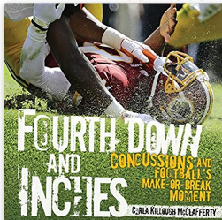
UNDEFEATED
Author website: http://stevesheinkin.com/
Educator’s guide: https://images.macmillan.com/folio-assets/teachers-guides/9781596439559TG.pdf
Book trailer: https://www.youtube.com/watch?v=XGGVvqGkLdI

Slide 45
THE WARDEN’S DAUGHTER By Jerry Spinelli
Summary: The story of a girl who must
come to terms with her mother's death
from inside the walls of a prison.

Slide 46
THE WARDEN’S DAUGHTER
Genre: Historical fiction
Accelerated Reader RL 4.1 Points 9
Reading Counts RL 4.2 Points 16
Lexile 550
F&P X
Word count 62344
Pages 341

Slide 47
THE WARDEN’S DAUGHTER
Partner with
1. Al Capone does my shirts by Gennifer Choldenko
And three sequels
2. All rise for the honorable Perry T. Cook by Leslie Connor
Author’s website: http://www.jerryspinelli.com/newbery_002.htm
Discussion guide http://www.novelstudies.org/downloads/The_Warden's_Daughter_Novel_Study_Preview.pdf
Book trailer: https://www.youtube.com/watch?v=lYi-Lx0LXOY
Author discusses book: https://www.youtube.com/watch?v=BUZ90M5c0F0

Slide 48
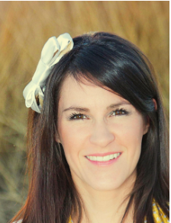
FORGET ME NOT By Ellie Terry
Summary: When her mother breaks up with yet another boyfriend, Calliope meets Jinsong at her latest middle school, who becomes her friend despite her Tourette Syndrome and the embarrassment it can cause.

Slide 49
FORGET ME NOT
Genre: Realistic fiction, verse
Accelerated Reader RL 4.1 Points 3
Reading Counts RL 5.2 Points 8
Lexile 670 HL
Word count 22377
Pages 330

Slide 50
FORGET ME NOT
Author’s website: https://ellieterry.com/
Discussion guide https://ellieterry.com/wp-content/uploads/2018/08/Forget-Me-Not-PDF.pdf
Book trailer https://www.youtube.com/watch?v=o_FgucYL3gI
Tourette’s for kids: https://kidshealth.org/en/kids/k-tourette.html
Tourette’s kids quest https://www.cdc.gov/ncbddd/kids/tourette.html

Slide 51
BEYOND THE BRIGHT SEA By Lauren Wolk
Summary: Twelve-year-old orphan Crow
embarks on a journey to discover who her parents were and why they abandoned her as an infant.

Slide 52
BEYOND THE BRIGHT SEA
Genre: Historical fiction, mystery
Accelerated Reader RL 4.8 Points 9
Reading Counts RL 4.7 Points 16
Lexile 770
Word count 61837
Pages 283

Slide 53
BEYOND THE BRIGHT SEA
Author’s website: http://www.laurenwolk.com/
Discussion questions: https://www.penguin.com/wp-content/uploads/2017/05/25690-BeyondBrightSea_DiscGuide1.pdf
Book trailer: https://www.youtube.com/watch?v=iAlRqPb0dDI
Partner with
Orphan Island by Laurel Snyder

Slide 54
Margaret.nanak@pinebluffschools.org

