Slide 1
The Science Behind Multisensory Learning – Why It's So Important When Teaching Foundational Skills
Kristin Gigliotti

Slide 2
Introduction
Learn how to shift from heavy reliance on written text to multisensory learning techniques in the K-2 classroom, leading to deeper connections, improved retention, and increased engagement in emergent readers.

Slide 3
Agenda
Foundational skills
The science
What this means for instruction
Growing minds with hands-on learning

Slide 4
“Education is not the learning of facts, but the training of the mind to think.”
Albert Einstein

Slide 5
Early Foundational Skills
Vocabulary and Comprehension
Fluency
Phonics
Phonemic Awareness
Phonological Awareness

Slide 6
What is the Science of Reading?
Approach to the teaching of reading based on the idea that students need explicit and systematic instruction in the essential components of reading:
phonological and
phonemic awareness
phonics
fluency
vocabulary
reading comprehension (the ultimate goal of reading)

Slide 7
3 Stages of Reading Development
Letters and sounds
necessary for both phonic decoding and sight-word learning
Phonic decoding
Orthographic mapping
process that occurs when unfamiliar words become automatic sight words
using the relationship between sounds and letters to make meaning from words and sentences
**The ultimate goal of reading is comprehension.

Slide 8
Some definitions:
Phonological Awareness
Foundation of reading ~ where it all starts
Words and their parts
Phonemic Awareness
Subset of Phonological Awareness ~ the next step
Word parts and their sounds
Phonics
Relationship between sounds of written letters and words
Sounds and their representation
*Children who struggle with Phonological and Phonemic Awareness will have a difficult time with Phonics*

Slide 9
Fluency has two parts and is the bridge between word recognition and language comprehension
Automaticity
Prosody (expression)
Vocabulary – the words that we know
Vocabulary and comprehension are two sides of the same coin
Listening comprehension in early grades through high-quality text helps prepare older students for reading comprehension
(My Reading Academy: Age of Learning)

Slide 10
“There is no comprehension strategy powerful enough to compensate for the fact that you can’t read the words.”
Dr. Anita Archer

Slide 11
But comprehension is the ultimate goal of reading, right?
No one is born with the ability to connect vision and speech; this must be done through successful instructional experiences.

Slide 12
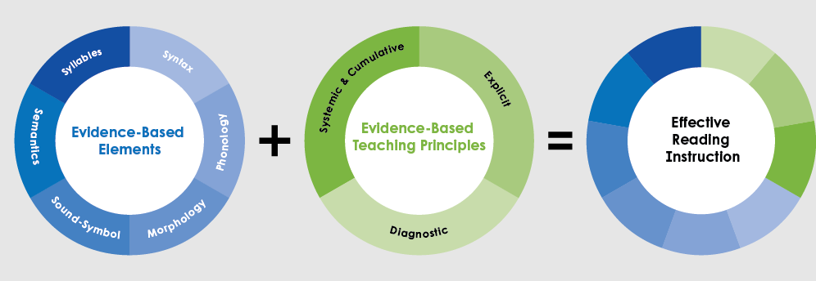
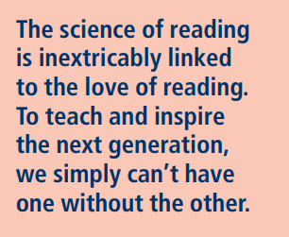
What does this mean for instruction?
Because the science says that instruction needs to be systematic and explicit, schools are shifting to a structured approach to literacy.

Slide 13
Scarborough's Reading Rope:

Slide 14
Simple View: WR x LC = RC
Word Recognition
Language Comprehension
Reading Comprehension
Phonological Awareness
Decoding
Sight Recognition
Background knowledge
Vocabulary
Language structure
Verbal reasoning
Literacy knowledge (print concepts, genre, etc)
70% of struggle goes back to Word Recognition
10% is in Language Comprehension
20% is both

Slide 15
“Tell me and I forget. Teach me and I remember. Involve me and I learn.”
Benjamin Franklin

Slide 16
Multisensory Approach
Auditory, Visual, Kinesthetic, Tactile
This is an approach to instruction~ not to be confused with learning styles
Auditory- relating to the sense of hearing
Visual- relating to seeing or sight
Kinesthetic- relating to the awareness of position and movement
Tactile - of or connected with the sense of touch

Slide 17
Benefits of multisensory instruction
Benefits
Motivating and engaging
Uses multiple areas of the brain
Makes activities more memorable
Increases skill acquisition
Motivating and engaging
Uses multiple areas of the brain
Makes activities more memorable
Increases skill acquisition

Slide 18
Multisensory Learning Intensifies the Impact of Instruction
Hebb’s Rule
Neurons that fire together, wire together.
Auditory
Kinesthetic Tactile
Visual
Notes:
What really sets hand2mind solutions apart is the way we incorporate multisensory resources into everything.
Multisensory instruction (visual, auditory, kinesthetic, and tactile) is incredibly important when learning how to read.
Neuroscience as helped us understand what happens in the brain as an emergent reader learns to read. From brain scans we now know that learning to read is all about making neural connections in the brain.
Multisensory instruction, because it involves different senses and different parts of the brain, fires off more neurons, resulting in a higher chance that children will retain the information that they are learning.
In other words, it strengthens the learning. It's like using a type of super glue vs. a common glue.
We like to say that our hands-on, multisensory solutions make literacy stick!

Slide 19
“Play gives children a chance to practice what they are learning.”
Fred Rogers

Slide 20
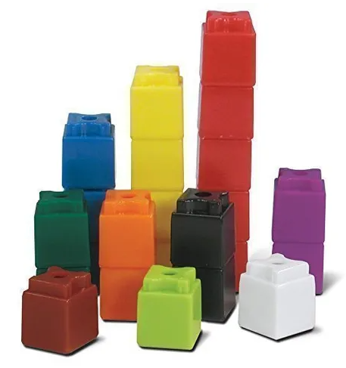
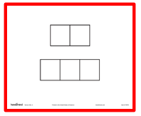
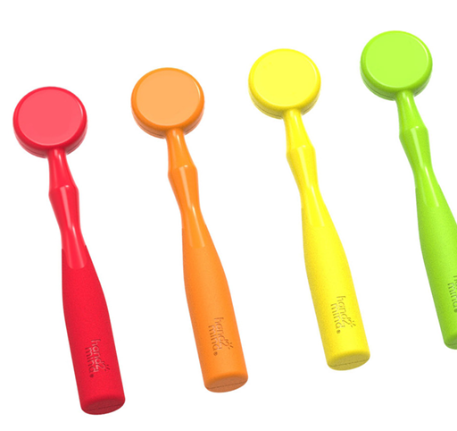
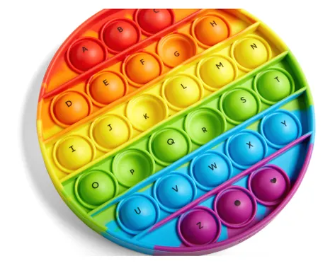
PHONOLOGICAL AWARENESS
Cubes or other counters with Elkonin Boxes
Magnetic wands and chips
Bubble poppers
Segmenting and blending word parts
Manipulating words

Slide 21
PHONEMIC AWARENESS
Cubes or other counters with Elkonin Boxes
Magnetic wands and chips
Bubble poppers
Segmenting and blending sounds
Manipulating sounds

Slide 22
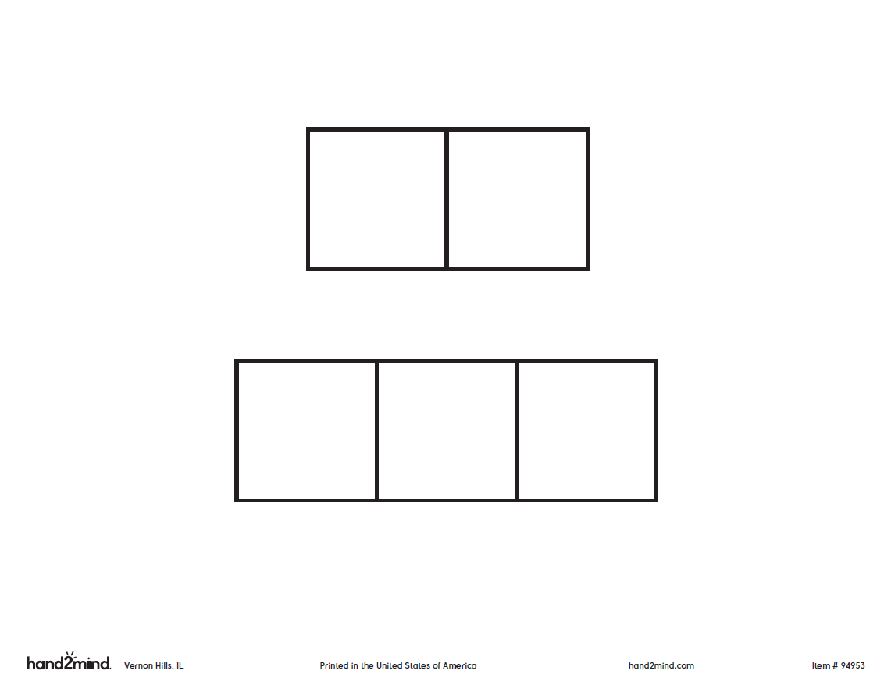
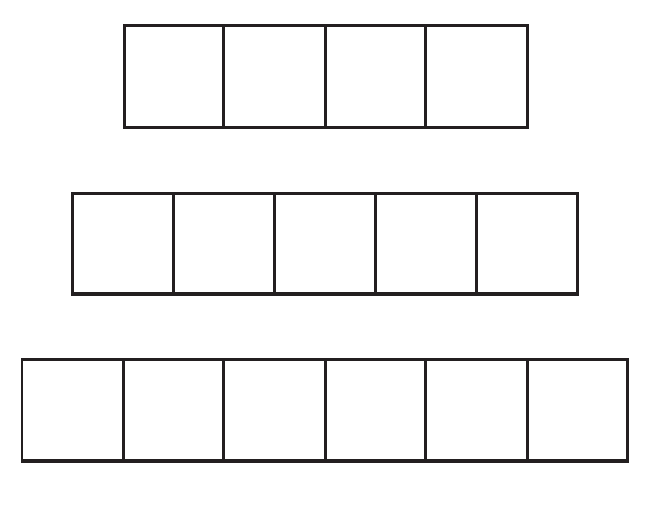
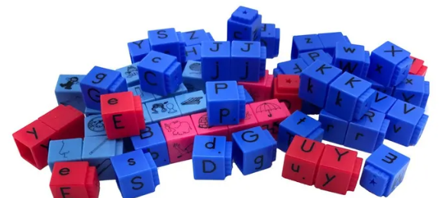
PHONICS
Write letters in Elkonin Boxes
Pop words with poppers
Build words with letter manipulatives
Highlight letters and words while reading
Encoding
Decoding
Manipulating

Slide 23
“Teaching reading is rocket science.”
Louisa C. Moats

Slide 24
Thank you!
Questions, Comments
Contact me at:
kgigliotti@hand2mind.com

