Slide 1
Charlie May Simon
2015-2016
Reading List
Margie Nanak
Arkansas Reading Association
Literacy… the app for life
November 20, 2015

Slide 2

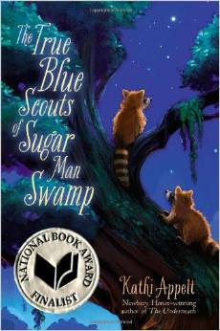
The true blue scouts of Sugar Man Swamp by Kathy Appelt
Summary: Twelve-year-old Chap Brayburn, ancient Sugar Man, and his raccoon-brother Swamp Scouts Bingo and J'miah try to save Bayou Tourterelle from feral pigs Clydine and Buzzie, greedy Sunny Boy Beaucoup, and world-class alligator wrestler and would-be land developer Jaeger Stitch.

Slide 3
The true blue scouts of Sugar Man Swamp
Genre – Humorous fiction
Accelerated Reader
RL 5.4 Points 8.0
Reading Counts
RL 5.3 Points 12.0
Lexile 810
2013 National Book Award Finalist, Young People's Literature

Slide 4
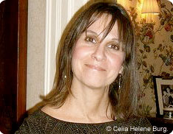

Serafina’s Promise by Ann E. Burg
Summary:
In a poor village outside of Port-au-Prince, Haiti, Serafina works hard to help her family, but dreams of going to school and becoming a doctor--then the earthquake hits and Serafina must summon all her courage to find her father and still get medicine for her sick baby brother as she promised.
Notes:
Written in verse

Slide 5
Serafina’s Promise
Genre – Historical Fiction, Poetry
Accelerated Reader
RL 3.6 Points 3.0
Reading Counts
RL 4.3 Points 9.0
Lexile HL 590
ALA Best Books for Young Adults
IRA Notable Book for a Global Society

Slide 6
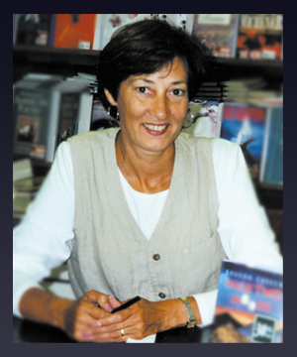
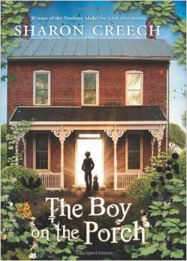
The Boy on the porch by Sharon Creech
Summary: When a young couple finds a boy asleep on their porch, their lives take a surprising turn. Unable to speak, the boy Jacob can't explain his history. All John and Marta know is that they have been chosen to care for him. And, as their connection and friendship with Jacob grow, they embrace his exuberant spirit and talents.

Slide 7
The Boy on the porch
Genre – Realistic Fiction
Accelerated Reader
RL 4.0 Points 3.0
Reading Counts
RL 4.2 Points 6
Lexile 680

Slide 8

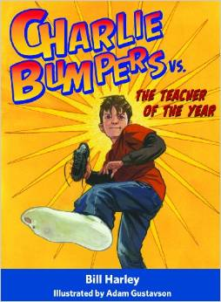
Charlie Bumpers vs. the teacher of the year by Bill Harley
Summary: Charlie Bumpers is sure he does not stand a chance of getting along with his fourth grade teacher and despite his best efforts to be neat and well-behaved, he always seems to be in trouble until he discovers her secret.
Notes:
Author of Lost and Found on this year’s Diamond Award list

Slide 9
Charlie Bumpers vs. the teacher of the year
Genre – Humorous Fiction
Accelerated Reader
RL 3.5 Points 3.0
Reading Counts
RL 2.8 Points 6
Lexile 510

Slide 10
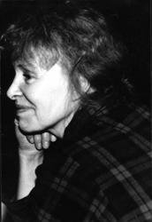
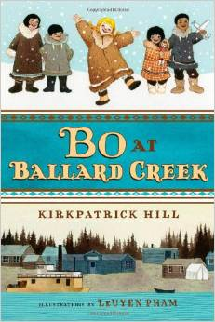
Bo at Ballard Creek by Kirkpatrick Hill
Summary: It's the 1920s, and Bo was headed for an Alaska orphanage when she won the hearts of two tough gold miners who set out to raise her, enthusiastically helped by all the kind people of the nearby Eskimo village.

Slide 11
Bo at Ballard Creek
Genre – Historical fiction
Accelerated Reader
RL 5.2 Points 7.0
Reading Counts
RL 5.5 Points 11
Lexile 840
2014 Scott O’Dell Award for Historical Fiction

Slide 12
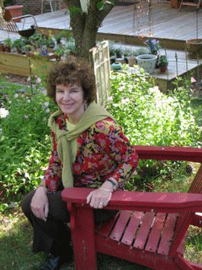
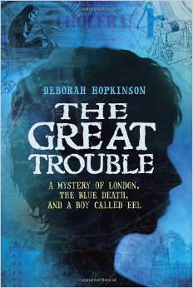
The Great Trouble: a mystery of London, the blue death, and a boy called Eel by Deborah Hopkinson
Summary: Eel, an orphan, and his best friend Florrie must help Dr. John Snow prove that cholera is spread through water, and not poisonous air, when an epidemic sweeps across their London neighborhood in 1854.

Slide 13
The Great Trouble
Genre – Historical fiction
Accelerated Reader
RL 4.6 Points 7.0
Reading Counts
RL 3.8 Points 11
Lexile 660

Slide 14
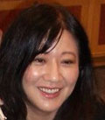
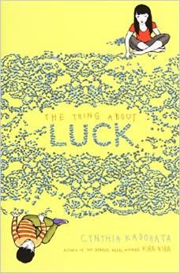
The thing about luck by Cynthia Kadohata
Summary: Just when twelve-year-old Summer thinks nothing else can possibly go wrong in a year of bad luck, an emergency takes her parents to Japan, leaving Summer to care for her little brother while helping her grandmother cook and do laundry for harvest workers.

Slide 15
The thing about luck
Genre – Realistic fiction
Accelerated Reader
RL 4.7 Points 7.0
Reading Counts
RL 4.3 Points 13
Lexile 700
National Book Award Winner, 2013
Asian-Pacific American Award for Literature Children’s Literature winner

Slide 16
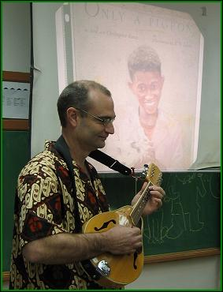
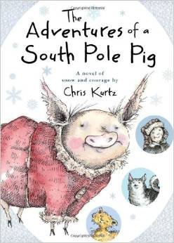
The adventures of a South Pole pig by Chris Kurtz
Summary: Flora the pig ditches the sedentary life on the farm for an adventure in Antarctica, where she escapes the knife and lives her dream of pulling a sled with a team of dogs.

Slide 17
The adventures of a South Pole pig
Genre – Fiction, Action/Adventure
Accelerated Reader
RL 4.6 Points 6.0
Reading Counts
RL 3.8 Points 10
Lexile 660

Slide 18

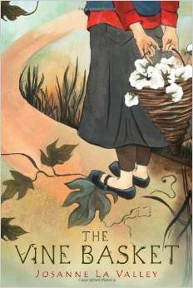
The vine basket by Josanne La Valley
Summary: Life has been hard for fourteen-year-old Mehrigul, a member of the Uyghur tribal group scorned by the Chinese communist regime, so when an American offers to buy all the baskets she can make in three weeks, Mehrigul strives for a better future for herself and her family despite her father's opposition.

Slide 19
The vine basket
Genre – Realistic fiction
Accelerated Reader
RL 5.0 Points 7.0
Reading Counts
RL 4.5 Points 13
Lexile 740
Notable Books for a Global Society - 2014 List
Asian-Pacific American Award for Literature Children’s Literature Honor

Slide 20
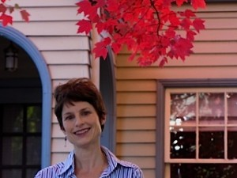
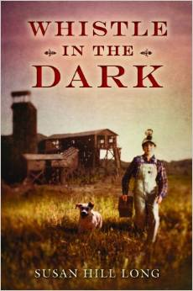
Whistle in the dark by Susan Hill Long
In a small town during the 1920s, Clem is torn between family responsibility and the life he wishes to lead when he must begin working in the lead mine on his thirteenth birthday to help pay for his sister's medical care.

Slide 21
Whistle in the dark
Genre – Historical fiction
Accelerated Reader
RL 5.1 Points 7.0
Reading Counts
RL 4.5 Points 11
Lexile 740

Slide 22
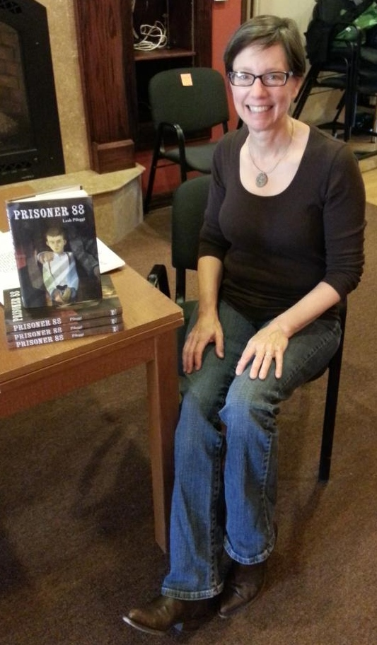
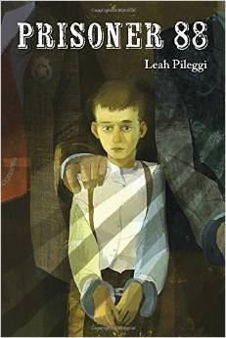
Prisoner 88 by Leah Pileggi
Summary: In 1885, ten-year-old Jake is sent to prison for killing a man who threatened his father, and struggles to survive the harsh realities of prison life in the Idaho Territory.

Slide 23
Prisoner 88
Genre – Historical fiction
Accelerated Reader
RL3.9 Points 4.0
Reading Counts
RL 3.5 Points 8
Lexile 620
2013 list of Notable Children's Books in the Language Arts by the NCTE

Slide 24

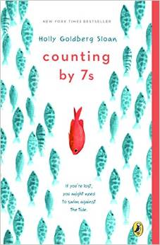
Counting by 7’s by Holly Goldberg Sloan
Summary: Twelve-year-old genius and outsider Willow Chance must figure out how to connect with other people and find a surrogate family for herself after her parents are killed in a car accident.

Slide 25
Counting by 7’s
Genre – Realistic Fiction
Accelerated Reader
RL 5.6 Points 10.0
Reading Counts
RL4.7 Points 16
Lexile 770

Slide 26
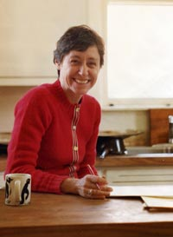
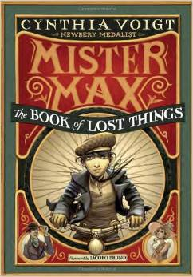
The book of lost things by Cynthia Voigt
Summary: When Max's parents leave the country without him, he must rely on his wits to get by, and before long he is running his own--rather unusual--business.

Slide 27
The book of lost things
Genre – Fiction, Mystery and Suspense
Accelerated Reader
RL 5.8 Points 14.0
Reading Counts
RL 5.7 Points 21
Lexile 890

Slide 28
Summaries
Credits
Summaries from the Bound to Stay Bound website.
Author photos from their websites.
Book covers from Amazon.com website.

